Slide 1

Subscription Churn Early-Warning & Retention Strategy Immensity OTT Platform
Case study based on a simulated OTT subscription platform
Objective:
Predict Churn 7-14 days early and recommend targeted retention strategies.
Subscription platforms rely on consistent user retention for revenue stability.
Rising churn negatively impacts recurring subscription revenue and long-term customer value.
This project analyses churn patterns and develops a predictive early-warning system.

Slide 2
Data Engineering & ETL Pipeline
Data Sources Used:
Users dataset
Subscription dataset
Usage activity logs
Payment Transactions
Campaign Touchpoints
Process:
Built a Python ETL pipeline to clean and standardize raw data.
Created curated analysis datasets:
dim_users_enriched
fact_user_weekly
model_churn_dataset
Outcome:
Prepared structured datasets for analytics and machine learning modelling.

Slide 3
Retention drops significantly within the first few months of subscription
Cohort analysis tracks retention behaviour across signup cohorts.
Retention declines gradually over time across cohorts.
Key Insight
Largest retention drop occurs within the first few months of subscription.
Early engagement is critical to long-term retention.

Slide 4
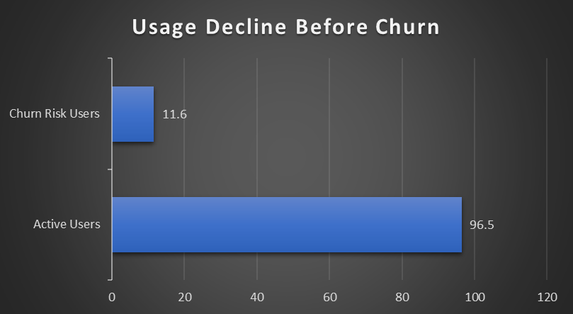
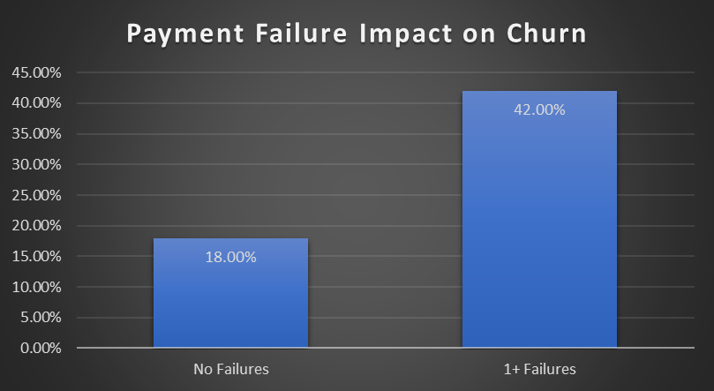
Declining user engagement is the strongest early warning signal of churn
Users who churn exhibit significantly lower engagement before cancellation.
Average engagement among churned users drops dramatically.
Key Insight:
Users who churn show approximately 80-90% lower engagement prior to cancellation, making usage decline a strong early-warning signal.

Slide 5
Machine learning models predict churn with strong accuracy (ROC-AUC ≈ 0.92)
Two machine learning models were trained:
Logistic Regression
Random Forest
Model Performance:
ROC-AUC ≈ 0.92
Accuracy ≈ 89%
Top Predictive Features:
Usage decline trend.
Average session activity
Minutes used
Days since last activity
Subscription price band
Key Insight:
Behavioural engagement features provide strong predictive power for churn detection.

Slide 6
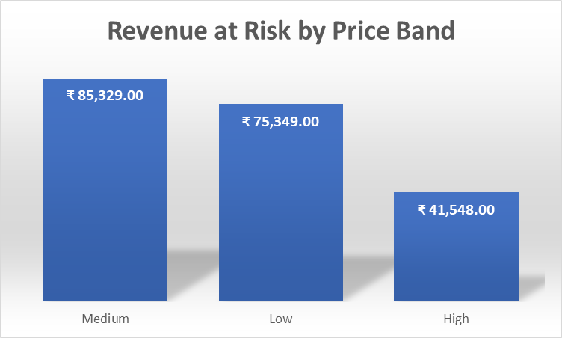
Medium-priced subscription plans represent the largest revenue exposure to churn
Churn not only reduces users but also impacts subscription revenue.
Medium priced plans represent the largest revenue exposure due to churn.
Key Insight
Identifying high-risk users allows the company to protect significant subscription revenue.

Slide 7
Targeting high-risk users enables proactive churn reduction
User Segment | Strategy
High Risk + High Revenue | Immediate retention offer
Medium Risk | Engagement campaigns
Low Risk | Monitor usage behaviour
Using early churn prediction enables targeted interventions that reduce churn risk and improve long-term customer value.

Slide 8
Business Impact Summary
Churn prediction accuracy ~89%
19% users identified as high risk
Medium-price plans carry highest revenue exposure
Early intervention strategy proposed

